Slide 1


Slide 2
About ChiroTouch
ChiroTouch is the leader in Chiropractic Practice Management Software, with over 18,000 DC’s. We offer a digital patient intake questionnaire and documentation system specific to auto, cycle, pedestrian and slip/fall injuries. ChiroTouch is working closely with Jim Mathis to provide all the necessary “value drivers” to aide professionals in securing the best possible insurance settlements for their patients.

Slide 3


THE DIFFERENCE BETWEEN
WORKING LATE & WORKING OUT
In order to gain the attention of our current prospects, we
cannot interrupt what they are interested in, we must be what they are interested in.
IT’S ABOUT TIME FOR:
More Family Time
More Personal Time
More Practice Growth
More Time With Patients

Slide 4
IMAGINE WHAT YOUR PRACTICE CAN DO WITH AN EXTRA 80 HOURS PER MONTH!*
*Based on a practice with a staff or 4 seeing 100 patients per week. Results may very.

Slide 5
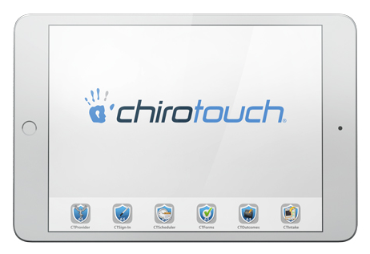
Your Practice – At Your Fingertips
Our six user-friendly, native iPad apps make documenting on the tablet easy and provide you with mobility to move room to room with patients. Native iPad apps provide a better user experience than web-base apps through improved speed and performance, as well as providing safety and security of the app, due to the requirements of apps in the Apple App Store.

